Slide 1
SQL JOINS

Slide 2
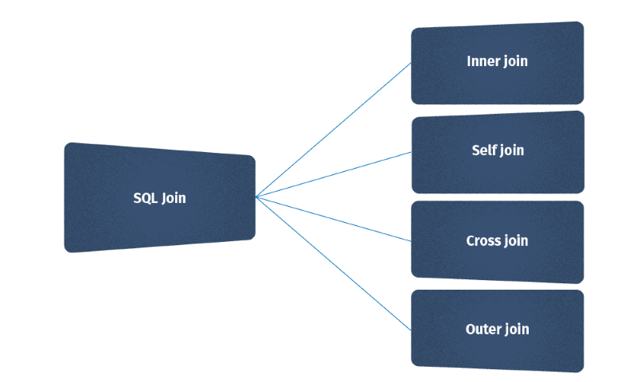
Introduction
JOIN is a method of combining (joining) information from two tables.
Merging two data sets using SQL or SQL tools can be accomplished through JOINS. A JOIN is a SQL instruction in the FROM clause of your query that is used to identify the tables you are querying and how they should be combined.
A table may be joined to itself or to any other table. If information from more than two tables needs to be accessed, multiple joins can be specified in a FROM clause.

Slide 3
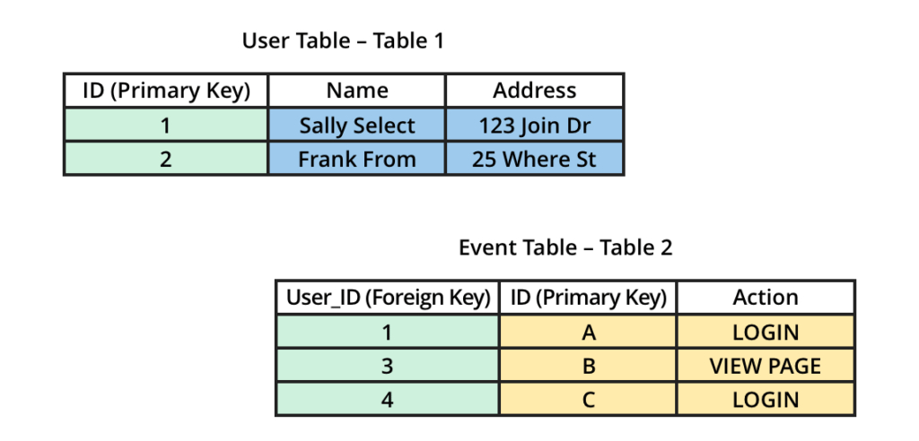
In the example below, we have two tables: User Table (Table 1) and Event Table (Table 2). We want to join the two tables together to get user data alongside their events data. A real-life example of this would be if you had data from a CRM tool like Salesforce containing users who are paid customers (Table 1) and an events analytics tool like Mixpanel that tracks all the users that have performed an action in your product (Table 2).
Notice that between the two tables there is a common column (dimension) highlighted in green, User ID. In the User Table, the ID column is the user ID and it’s the primary key for that table whereas, in the Event Table, the User_ID column is the foreign key since that column refers to the ID column in the Users table. We can use this relationship to join the two tables together to get the user and events information in one table.

Slide 4
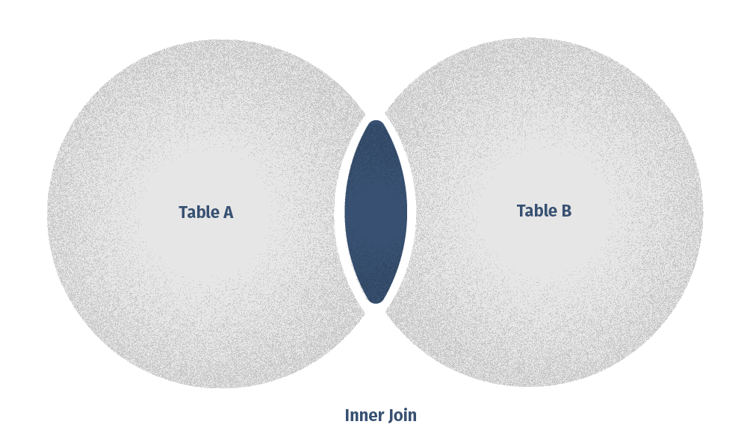
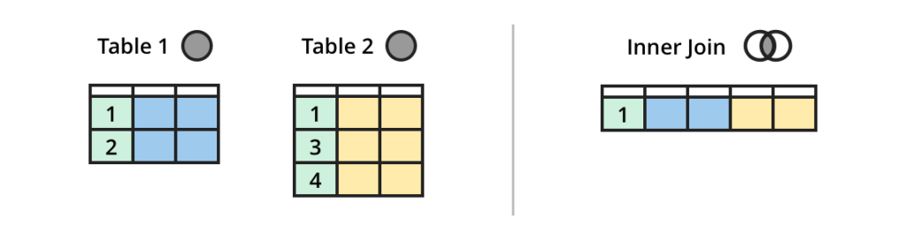
Meet the joins
INNER JOIN
INNER JOIN statement returns only those records or rows that have matching values and is used to retrieve data that appears in both tables. An inner join using either of the equivalent queries gives the intersection of the two tables, i.e. the two rows they have in common:

Slide 5
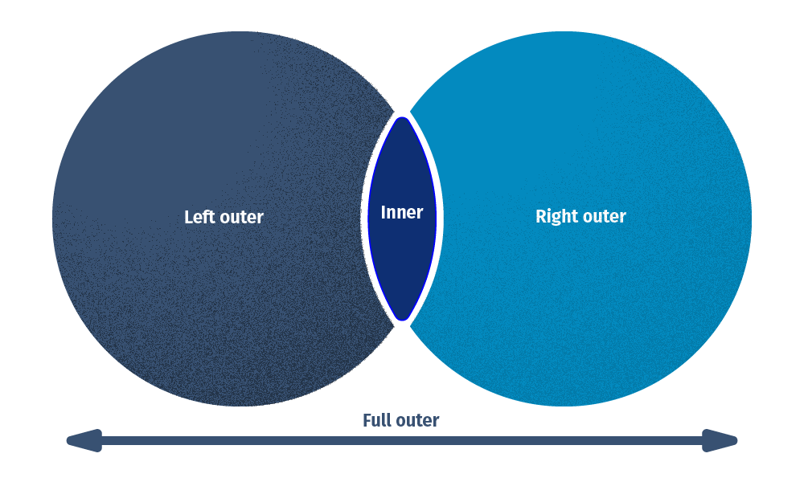
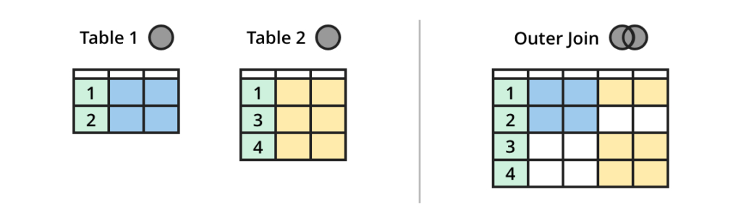
OUTER JOIN
When applying an SQL INNER JOIN, the output returns only matching rows from the stated tables. In contrast, if you use an SQL OUTER JOIN, it will retrieve not only the matching rows but also the unmatched rows as well. A full outer join will give you the union of A and B, i.e., all the rows in A and all the rows in B. If something in A doesn't have a corresponding datum in B, then the B portion is null, and vice versa.

Slide 6
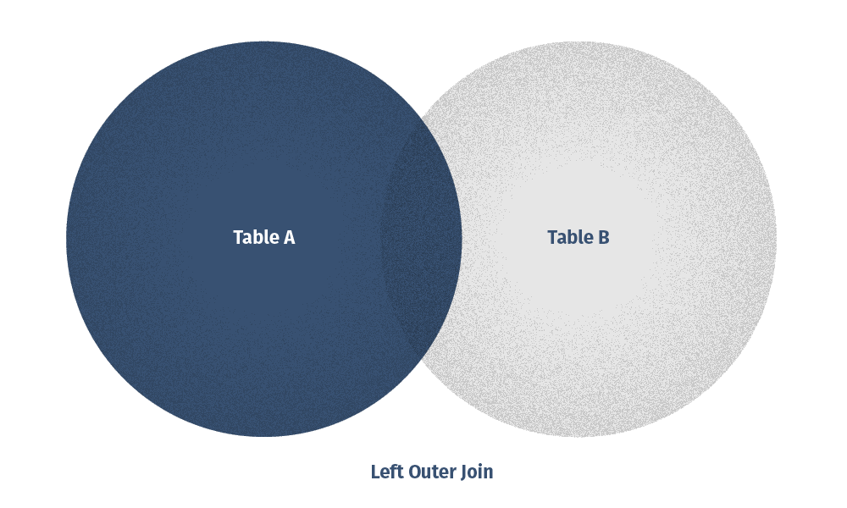
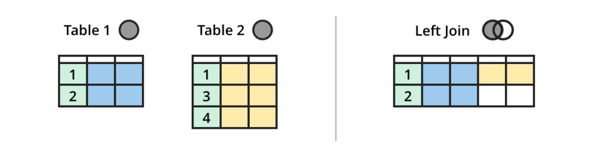
LEFT OUTER JOIN
The LEFT OUTER JOIN gives the output of the matching rows between both tables plus the rows in table1. In case, no records match from the left table, it shows those records with null values.
A left outer join will give all rows in A, plus any common rows in B:

Slide 7
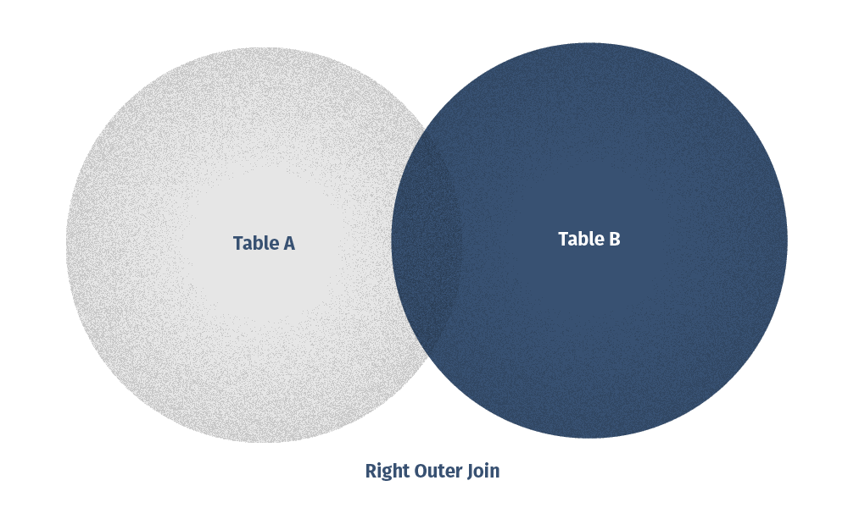
RIGHT OUTER JOIN
The RIGHT OUTER JOIN works by the same principle as the LEFT OUTER JOIN. The RIGHT OUTER JOIN selects data from the right table (Table B) and matches this data with the rows from the left table (Table A). The RIGHT JOIN returns a result set that includes all rows in the right table, whether or not they have matching rows from the left table. In case, a row in the right table does not have any matching rows in the left table, the column of the left table in the result set will have nulls.

Slide 8
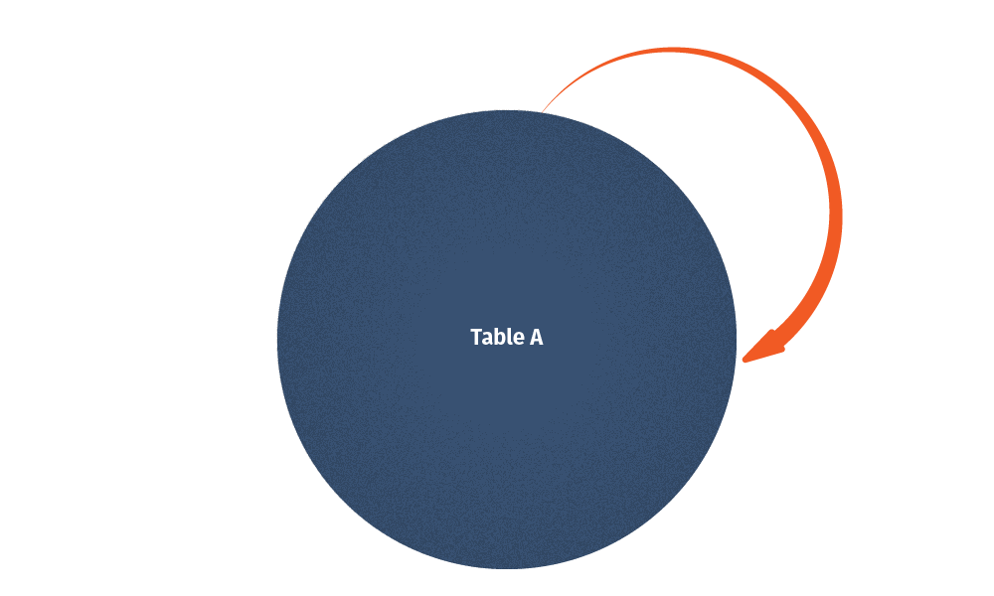
SELF JOIN
The SELF JOIN allows you to join a table to itself. This implies that each row of the table is combined with itself and with every other row of the table. The SELF JOIN can be viewed as a join of two copies of the same table. The table is not actually copied, but SQL performs the command as though it were. This is accomplished by using table name aliases to give each instance of the table a separate name. It is most useful for extracting hierarchical data or comparing rows within the same table.

Slide 9
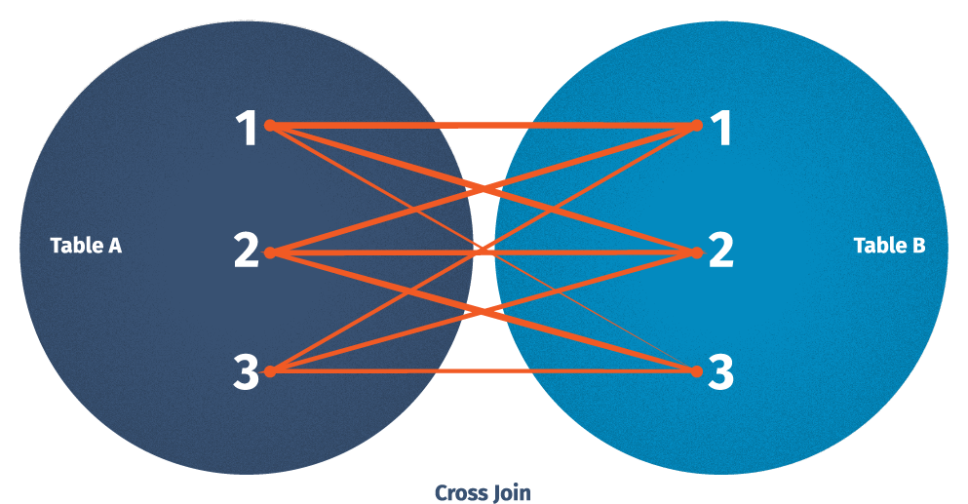
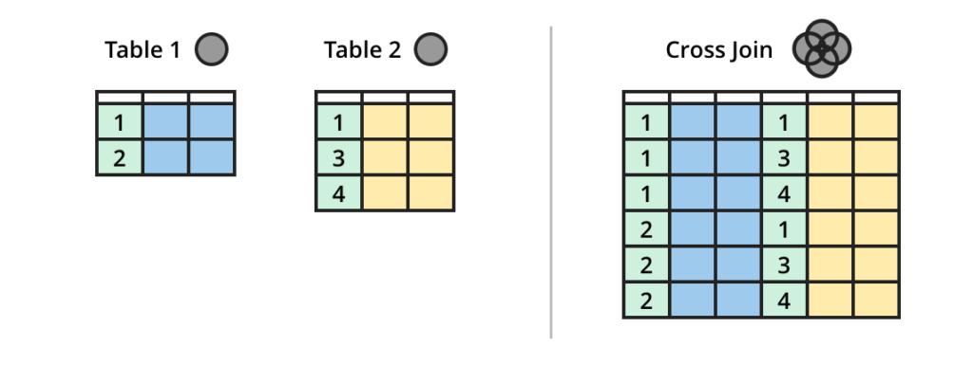
CROSS JOIN
The CROSS JOIN command in SQL, also known as a Cartesian join, returns all combinations of rows from each table. Envision that you need to find all combinations of size and colour. In that case, a CROSS JOIN will be an asset. Note, that this join does not need any condition to join two tables. In fact, CROSS JOIN joins every row from the first table with every row from the second table and its result comprises all combinations of records in two tables.

Slide 10
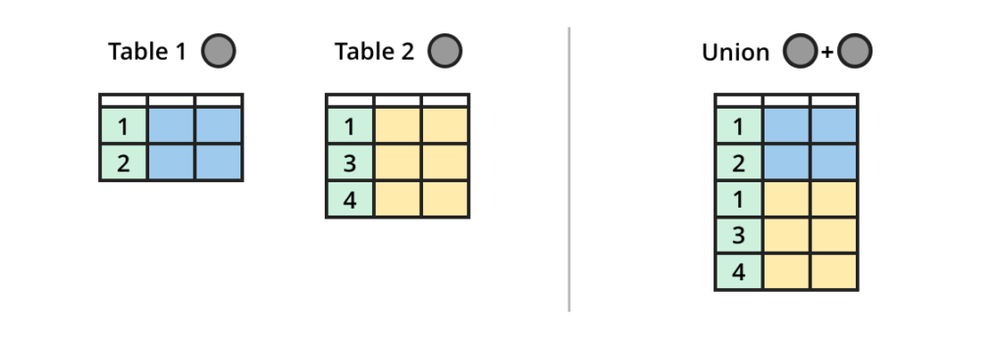
UNION
A Union Join will stack tables on top of each other resulting in new rows. The union operator is used to combine the data from the result of two or more SELECT command queries into a single distinct result set. This operator removes any duplicates present in the results being combined.

